Slide 1
Analysis of Factors Driving Medical Costs
Magnum API
Brian Salant, Dylan Howe, Luke Morrissey, Connor Cute

Slide 2


Thesis Question
How does the cost and availability of healthcare vary throughout the country? What factors may be correlated with these disparities?

Slide 3
Questions & Data
Question One
Question Two
Are there any socioeconomic factors that correlate with higher admittance rates into drug rehab facilities across the US?
Are there hospital deserts? If so, what socioeconomic factors might play a role in their locations?

Slide 4
Questions & Data
Question Three
How does the cost of a healthcare visit vary across the country? Is healthcare more expensive in certain areas?

Slide 5
Questions & Data
Question One Explained
Question Two Explained
Our first question required us to get the rehab admission rate per capita for the states in order to compare it to compare it to hospital cost data.
Most of this data for the patient side of the equation, in reference to rehab, were found via the CDC whereas the data for the hospital procedure costs were found via government data on Medicare.
Using a database of zip code coordinates and general hospital information we were able to dig deeper into the question revolving around hospital deserts. This data allowed for us to plot hospital density and over lay it over zip code data while including other socio-economic data from the previously after mentioned zip code database.

Slide 6
Questions & Data
Question Three Explained
We created an index to compare the average cost of a basket of treatments across the country in relation to the mean. We used that index to compare the relative cost to various socioeconomic factors.

Slide 7
Motivation & Summary
Our hypotheses are that if there were that if more people in rehab local hospital cost would increase, cities are more expensive than rural, and that low-income areas are associated with hospital deserts.
In order to get the answers to our questions we had to ask what the main driving factors behind these three issues could be, mostly revolving around social, economic, and geographical factors.
While we did get results, they were somewhat marginal and muddled for a variety of reasons. Mostly, it was due to the large volume of ‘average’ results weakening any trends that might have emerged. In short, while our hypotheses are all somewhat supported if you look at specific sections of the data, one can accurately say that the second hypothesis the strongest while the first is the weakest.

Slide 8
Data Cleanup & Exploration
The Exploration and Cleanup Process
Some things that were unexpected while exploring and cleaning our data was how much some datasets varied from one other while they presumably have the same data. For example one in sight that we learned was how to make do with the data when a lot of data is missing. This, of course, resulted in a lot of messing with the data and combing through files and data sets for replacement information while still retaining accuracy.
This obviously led to some confusion and frustration while dealing with the data. It also resulted in some technical problems when it came to merging data and attempting to be as accurate as possible with our data. This also stemmed from the fact that we were trying to be accurate on as precise a level as zip codes, of which sometimes numbered over thirty thousand entries. In order to solve a lot of our problems regarding lack of data, varying data, and large volumes of data we had to be patient and not only work with multiple datasets but also brute force tons and tons of calculations and meshes in order to get our data to work together. One specific example would be the fact that the ZIP codes in Alaska are completely and utterly different from the rest of the continental US and even Hawaii. In order to solve this, we had to come through the data for the most accurate zip code latitude and longitudes and just run with what we thought was best. And in one specific instance it took code running through the datasets roughly four hours to complete.

Slide 9
Data Analysis
Steps of Analysis Question 1
For the first question we had to analyze two key datasets. The rehab dataset and the hospital cost dataset. We utilized both rehab data and the average cost of various, common procedures to create a baseline from which to work with. After including poverty data, it is easy to spot trends between the two datasets. This allows for us to make educated assumptions on the data to answer the question.

Slide 10
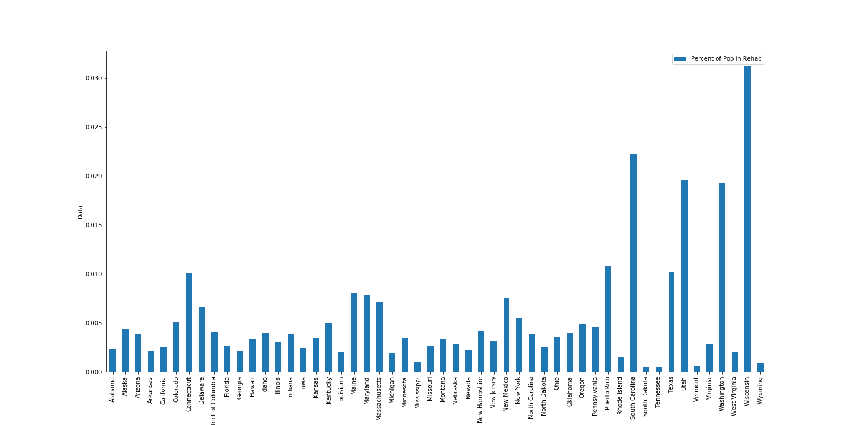
Data Analysis
Presentation of Analysis

Slide 11
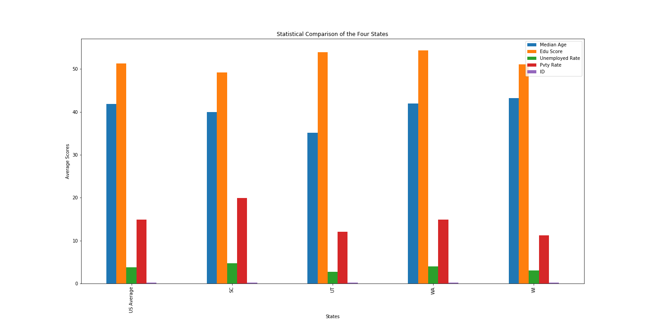
Data Analysis
Presentation of Analysis

Slide 12
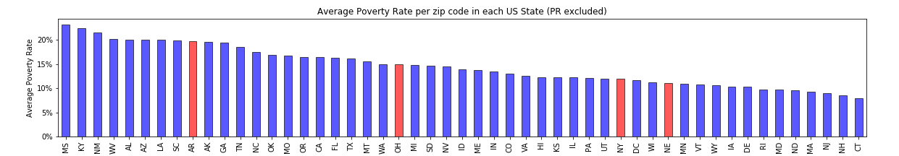
Data Analysis
Presentation of Analysis

Slide 13
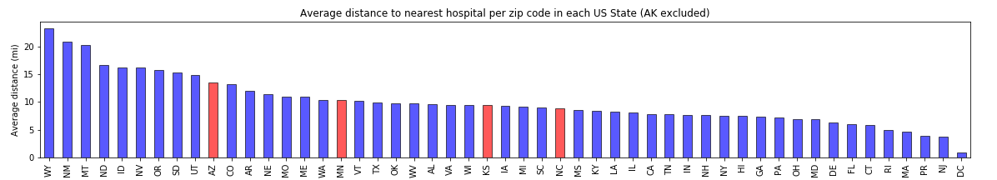
Data Analysis
Presentation of Analysis

Slide 14
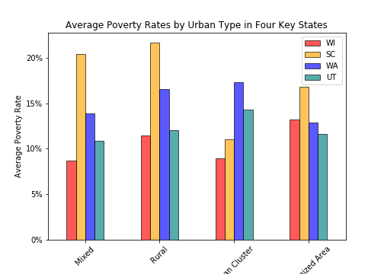
Data Analysis
Presentation of Analysis

Slide 15
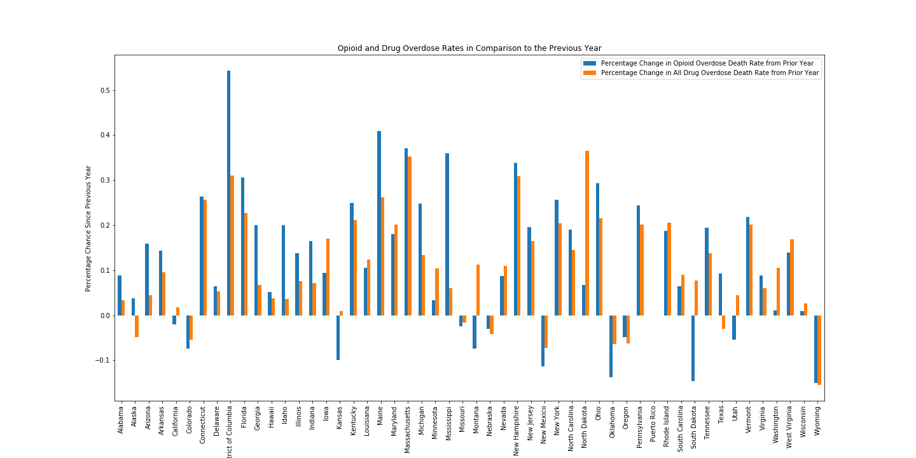
Data Analysis

Slide 16
Data Analysis
Steps of Analysis Question 2
Because we had to analyze zip code data for the second question this analysis took a bit more effort. This is also due to the fact that there were key markers that we had to take into consideration such as rural versus urban and run multiple baselines against those datapoints. This did leave us with a lot of visualizations which helps to paint a better picture in the end.

Slide 17
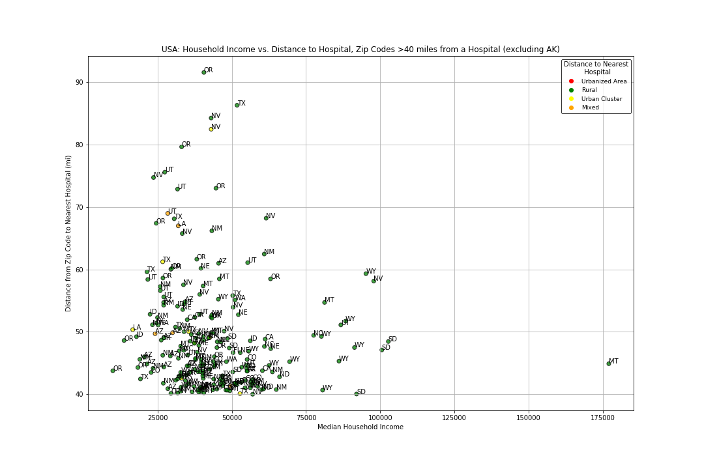
Data Analysis
Presentation of Analysis
Q2 Fig1

Slide 18
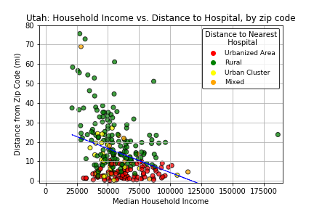
Data Analysis
Presentation of Analysis
Q2 Fig2

Slide 19
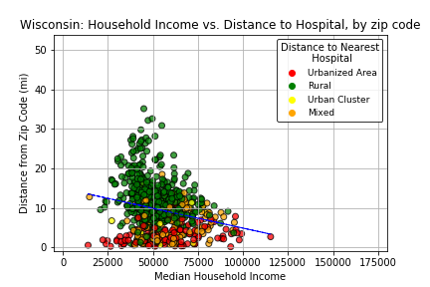
Data Analysis
Presentation of Analysis
Q2 Fig3

Slide 20
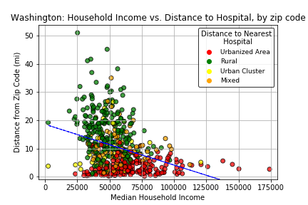
Data Analysis
Presentation of Analysis
Q3 Fig4

Slide 21
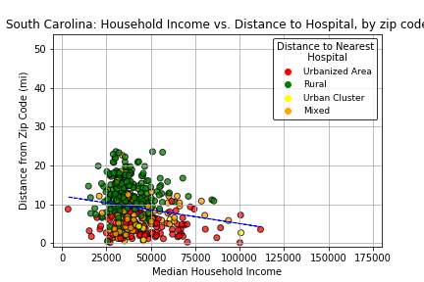
Data Analysis
Presentation of Analysis
Q3 Fig5

Slide 22
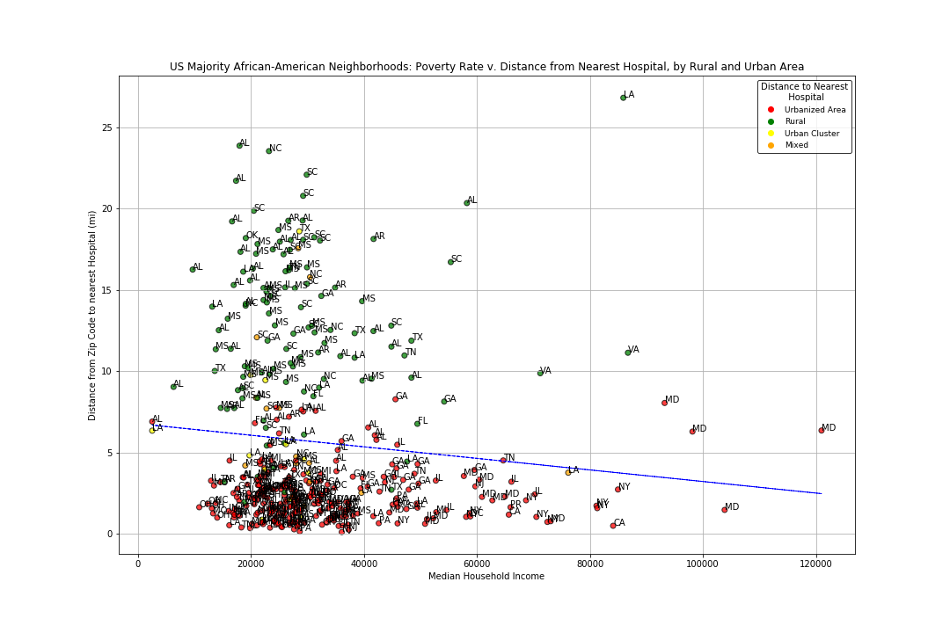
Data Analysis
Presentation of Analysis
Q3 Fig6

Slide 23
Data Analysis
Steps of Analysis Question 3
The third question was rather tricky to analyze, as it involved creating an index to measure the relative cost of healthcare in a zipcode. Grouping the data by state made it easier to notice any patterns within the data.

Slide 24
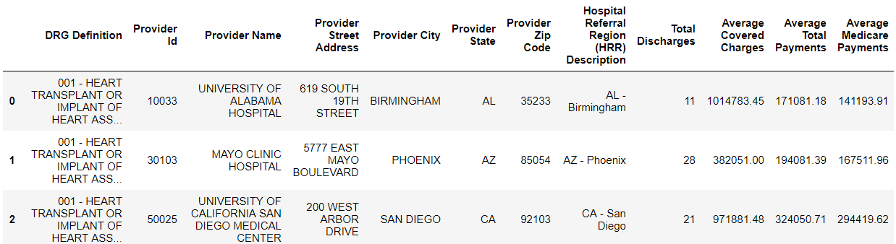
Data Analysis

Slide 25
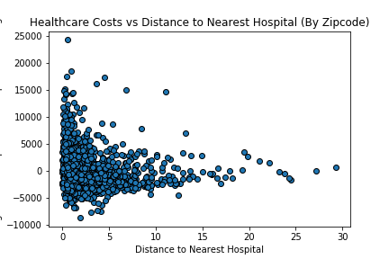
Data Analysis
Presentation of Analysis

Slide 26
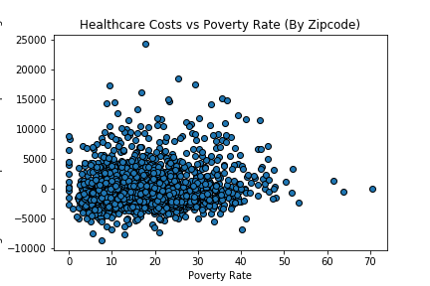
Data Analysis
Presentation of Analysis

Slide 27
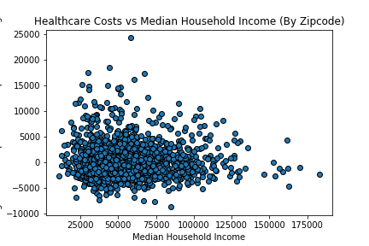
Data Analysis
Presentation of Analysis

Slide 28
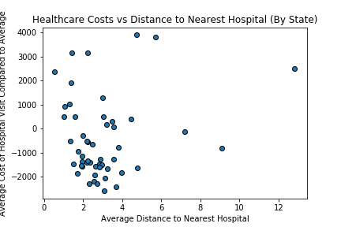
Data Analysis
Presentation of Analysis

Slide 29
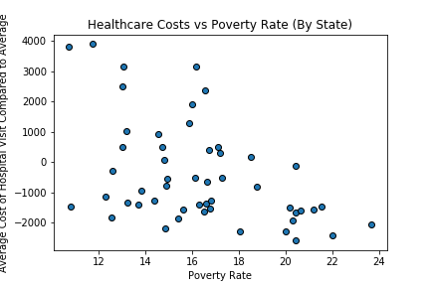
Data Analysis
Presentation of Analysis

Slide 30
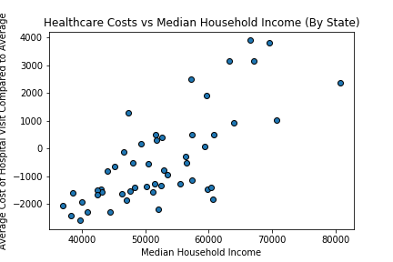
Data Analysis
Presentation of Analysis

Slide 31
Discussion
Findings
For the First question it is key to note that while it may seem that poverty has a large role in the cost it actually doesn’t have as large as a role of rehab rates. While there is some variation that can be accounted for via other variables, there appears to be a trend consistent with higher costs resulting from higher rehab percentages.
For the Second question one of the interesting points is that as median household income increases, the rural neighborhoods tend to be less far from a hospital. This seems to indicate that hospital deserts are mostly driven by wealth density, with rural getting the worst of it.
The Third question appears to heavily indicate that cities are indeed more expensive than rural areas regardless of income.

Slide 32
Post Mortem
Difficulties
Some of the difficulties that arose during this analysis are mainly due to its large size and multiple questions presented. While it will be easy to just say that it was project vision creep, it lends itself more to a variety of reasons. These reasons also take place in the actual analysis of the data itself mainly because of how much data and how many different comparisons were being made. This resulted in a somewhat cluttered analysis if not thorough. In order to deal with this a bunch of time was spent just simply going over the data but in the end it did take away from the impact and the conciseness and cohesiveness of the presentation and analysis.
There are also a bunch of technical problems that were mainly just due to inexperience or rather lack of use of specific types of code in order to properly analyze and visualize our data. Those were not as much of a concern as they were mostly dealt with just by Googling and assisting one another.
Additional Questions
Some additional questions that came up present themselves more in the form of a want or almost even a need to go deeper and have more cross analysis completed as opposed to the A versus B analysis presented. Also, it just comes down to not having as much time as would be preferred to tackle something this large.

Slide 33

Questions?

